Slide 1
Course : MCA Sem III
Subject : KR-AI-ML-DL
( Subject Code :IT-34 )

Slide 2
Subject : KR-AI-ML-DL
Course Outcomes:
CO1: Understand basic building block of Artificial Intelligence and Knowledge
Representation. (Understand)
CO2: Apply Propositional Logic for knowledge representation. (Apply)
CO3: Design various models based on Machine Learning methodology (Apply)
CO4: Design various models based on Deep Learning methodology (Apply)
CO5: Understand various hardware and software aspect used for AI and its
application. (Understand)

Slide 3
Chapt: 1 Artificial Intelligence and Knowledge Representation
Artificial Intelligence and Knowledge representation
1.1. Introduction to Artificial Intelligence and its evolution.
1.2. What is Intelligence and Artificial Intelligence
1.3. How AI is affecting on real life?
1.4. Different branches of AI
1.5. Limitations of AI
1.6. Need of knowledge Representation
1.7. Knowledge Representation and Mapping schemes
1.8. Properties of good knowledge-based system
1.9. Types of knowledge
1.10. Knowledge Representation issues
1.11. AND-OR Graph
1.12. The Wumpus World

Slide 4
1.1. Introduction to Artificial Intelligence and its evolution.
"It is a branch of computer science by which we can create intelligent machines which can behave like a human, think like humans, and able to make decisions."
AI exists when a machine can have human-based skills such as learning, reasoning, and solving problems.
With AI you do not need to pre-program a machine to do some work, despite that you can create a machine with programmed algorithms which can work with own intelligence.

Slide 5
Chapt: 1 Artificial Intelligence and Knowledge Representation
1.1. Introduction to Artificial Intelligence and its evolution.
Definitions Concerned with thought processes and reasoning
Thinking Humanly “The exciting new effort to make computers think . . . machines with minds, in the full and literal sense.” (Haugeland, 1985) “[The automation of] activities that we associate with human thinking, activities such as decision-making, problem solving, learning . . .” (Bellman, 1978 | Thinking Rationally “The study of mental faculties through the use of computational models.” (Charniak and McDermott, 1985) “The study of the computations that make it possible to perceive, reason, and act.” (Winston, 192)
Definitions addressing on behaviour
Acting Humanly “The art of creating machines that perform functions that require intelligence when performed by people.” (Kurzweil,1990) “The study of how to make computers do things at which, at the moment, people are better.” (Rich and Knight, 1991) | Acting Rationally “Computational Intelligence is the study of the design of intelligent agents.” (Poole et al., 1998) “AI . . . is concerned with intelligent behaviour in artifacts.” (Nilsson, 1998)
Figure 1.1 Some definitions of artificial intelligence, organized into four categories.

Slide 6
Chapt: 1 Artificial Intelligence and Knowledge Representation
1.1. Introduction to Artificial Intelligence and its evolution.
Maturation of Artificial Intelligence (1943-1952)
Year 1943: The first work which is now recognized as AI was done by Warren McCulloch and Walter pits in 1943. They proposed a model of artificial neurons.
Year 1949: Donald Hebb demonstrated an updating rule for modifying the connection strength between neurons. His rule is now called Hebbian learning.
Year 1950: The Alan Turing who was an English mathematician and pioneered Machine learning in 1950. Alan Turing publishes "Computing Machinery and Intelligence" in which he proposed a test. The test can check the machine's ability to exhibit intelligent behavior equivalent to human intelligence, called a Turing test.

Slide 7
Chapt: 1 Artificial Intelligence and Knowledge Representation
1.1. Introduction to Artificial Intelligence and its evolution.
The birth of Artificial Intelligence (1952-1956)
Year 1955: An Allen Newell and Herbert A. Simon created the "first artificial intelligence program"Which was named as "Logic Theorist". This program had proved 38 of 52 Mathematics theorems, and find new and more elegant proofs for some theorems.
Year 1956: The word "Artificial Intelligence" first adopted by American Computer scientist John McCarthy at the Dartmouth Conference. For the first time.

Slide 8
Chapt: 1 Artificial Intelligence and Knowledge Representation
1.1. Introduction to Artificial Intelligence and its evolution.
The golden years-Early enthusiasm (1956-1974)
Year 1966: The researchers emphasized developing algorithms which can solve mathematical problems. Joseph Weizenbaum created the first chatbot in 1966, which was named as ELIZA.
Year 1972: The first intelligent humanoid robot was built in Japan which was named as WABOT-1.
The first AI winter (1974-1980)
AI winter refers to the time period where computer scientist dealt with a severe shortage of funding from government for AI researches. Publicity on AI was decreased.
A boom of AI (1980-1987)
Year 1980: After AI winter duration, AI came back with "Expert System". Expert systems were programmed that emulate the decision-making ability of a human expert.

Slide 9
Chapt: 1 Artificial Intelligence and Knowledge Representation
1.1. Introduction to Artificial Intelligence and its evolution.
The second AI winter (1987-1993)
Investors and government stopped in funding for AI research as due to high cost but not efficient result.
The emergence of intelligent agents (1993-2011)
Year 1997: IBM Deep Blue beats(world chess champion), Gary Kasparov, and became the first computer to beat a world chess champion.
Year 2002: AI entered the home in the form of Roomba, a vacuum cleaner.
Year 2006: AI came Business world till the year 2006. Companies like Facebook, Twitter, and Netflix also started using AI.

Slide 10
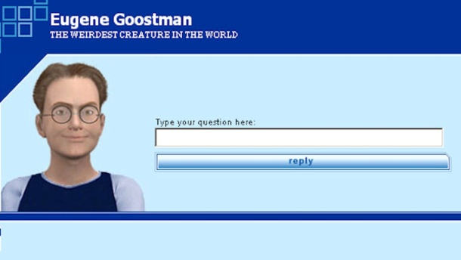
Chapt: 1 Artificial Intelligence and Knowledge Representation
1.1. Introduction to Artificial Intelligence and its evolution.
Deep learning, big data and artificial general intelligence (2011-present)
Year 2011: IBM's Watson won jeopardy, a quiz show, where it had to solve the complex questions as well as riddles. Watson proved that it could understand natural language and tricky questions quickly.
Year 2012: Google has launched an Android app feature "Google now", which was able to provide information to the user as a prediction.
Year 2014: In the year 2014, Chatbot "Eugene Goostman" won a competition in the infamous "Turing test.“
Year 2018: The "Project Debater" from IBM debated on complex topics.
Google’s AI program "Duplex“ a virtual assistant and which had taken hairdresser appointment on call.

Slide 11
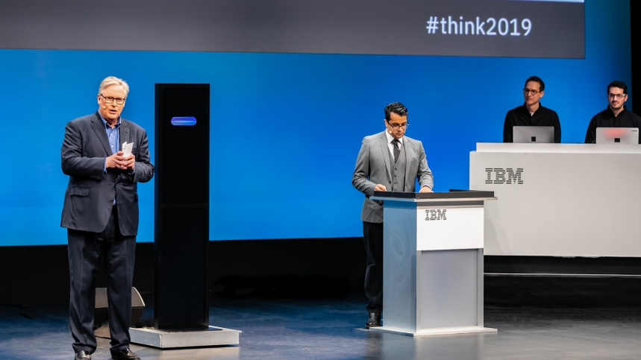
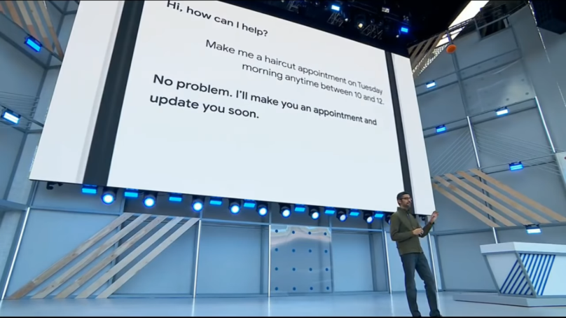
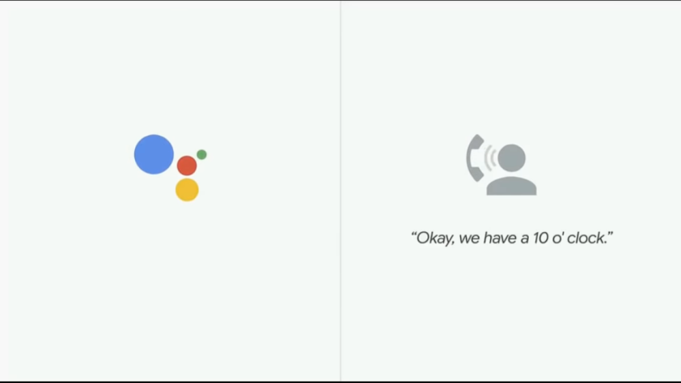
Chapt: 1 Artificial Intelligence and Knowledge Representation
1.1. Introduction to Artificial Intelligence and its evolution.
Deep learning, big data and artificial general intelligence ()
Debate
Google’s ‘Duplex’ Assistant

Slide 12
Chapt: 1 Artificial Intelligence and Knowledge Representation
1.2. What is Intelligence and Artificial Intelligence
Define : AI as the study of agents that receive percepts from the environment and perform actions
What is Artificial Intelligence?
Intelligence?
Intelligence has been defined in many ways: the capacity for abstraction, logic, understanding, self-awareness, learning, emotional knowledge, reasoning, planning, creativity, critical thinking, and problem-solving.

Slide 13
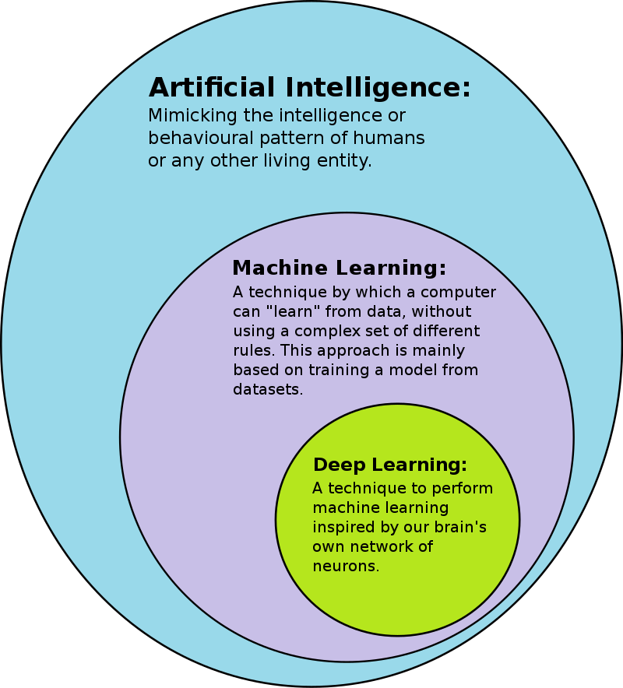
Chapt: 1 Artificial Intelligence and Knowledge Representation
1.2. What is Intelligence and Artificial Intelligence

Slide 14
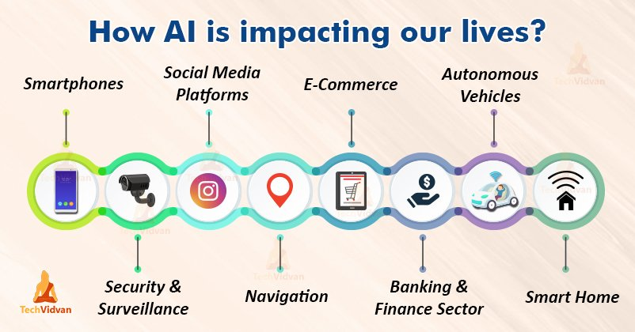
Chapt: 1 Artificial Intelligence and Knowledge Representation
1.3. How AI is affecting on real life?

Slide 15
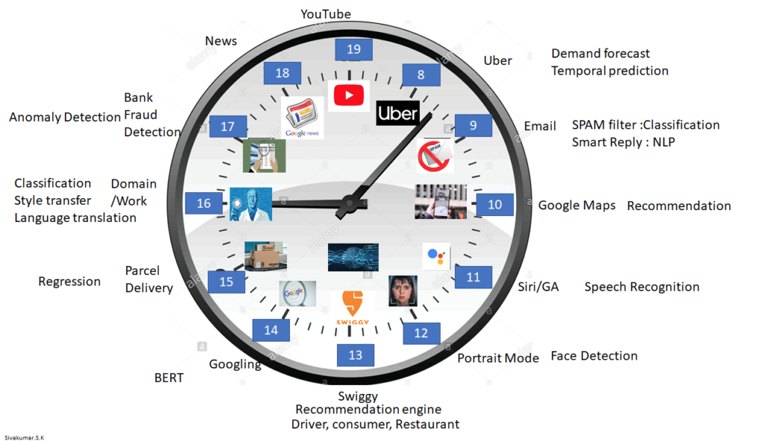
Chapt: 1 Artificial Intelligence and Knowledge Representation
1.3. How AI is affecting on real life?

Slide 16
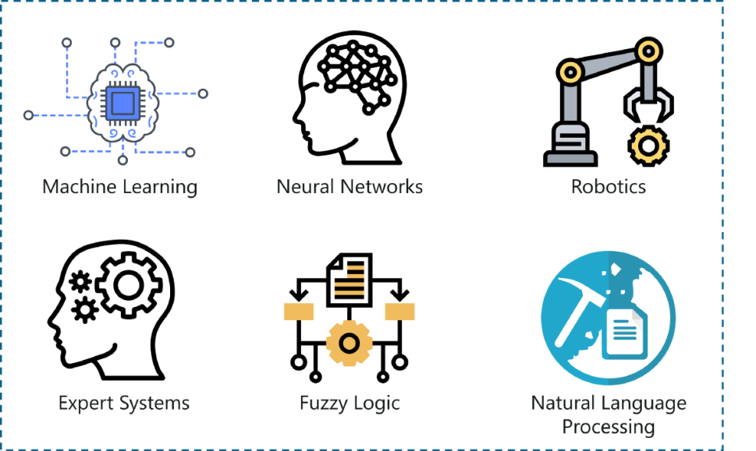
Chapt: 1 Artificial Intelligence and Knowledge Representation
1.4. Different branches of AI

Slide 17
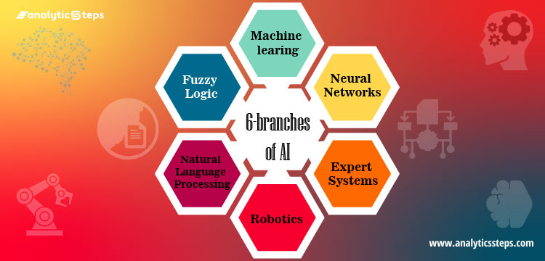
Chapt: 1 Artificial Intelligence and Knowledge Representation
1.4. Different branches of AI

Slide 18
Chapt: 1 Artificial Intelligence and Knowledge Representation
1.4. Different branches of AI
1. Machine learning
Machine Learning is the technique that gives computers the potential to learn without being programmed. it is the science that enables machines to translate, execute and investigate data for solving real-world problems.
self-driving cars, image and speech recognition, demand forecasting models, useful web search and various extensive applications. It basically converges on the applications that adapt from experience and advance their decision-making potential or predictive accuracy over a period of time.

Slide 19
Chapt: 1 Artificial Intelligence and Knowledge Representation
1.4. Different branches of AI
2. Neural Network
It is a branch of artificial intelligence that makes use of neurology ( a part of biology that concerns the nerve and nervous system of the human brain). Neural network replicates the human brain where the human brain comprises an infinite number of neurons and to code brain-neurons into a system or a machine is what the neural network functions.
Neural network refers to a system of neurons that are original . The artificial neurons are known as perceptrons

Slide 20
Chapt: 1 Artificial Intelligence and Knowledge Representation
1.4. Different branches of AI
3. Robotics
It mainly focuses on designing and constructing robots.
Robotics is an interdisciplinary field of science and engineering incorporated with mechanical engineering, electrical engineering, computer science, and many others. Robotics determines the designing, producing, operating, and usage of robots. It deals with computer systems for their control, intelligent outcomes, and information transformation.
Robots are deployed often for conducting tasks that might be laborious for humans to perform steadily. Major of robotics tasks involved- assembly line for automobile manufacturing, for moving large objects in space by NASA.

Slide 21
Chapt: 1 Artificial Intelligence and Knowledge Representation
1.4. Different branches of AI
4. Expert Systems
It refers to a computer system that mimics the decision-making intelligence of a human expert. It conducts this by deriving knowledge from its knowledge base by implementing reasoning and insights rules in terms with the user queries.
The effectiveness of the expert system completely relies on the expert’s knowledge accumulated in a knowledge base. The more the information collected in it, the more the system enhances its efficiency. For example, the expert system provides suggestions for spelling and errors in Google Search Engine.

Slide 22
Chapt: 1 Artificial Intelligence and Knowledge Representation
1.4. Different branches of AI
5. Fuzzy Logic
In the real world, sometimes we face a condition where it is difficult to recognize whether the condition is true or not, Fuzzy logic gives relevant flexibility for reasoning that leads to inaccuracies and uncertainties of any condition.
In simpler terms, Fuzzy logic is a technique that represents and modifies uncertain information by measuring the degree to which the hypothesis is correct. Fuzzy logic is also used for reasoning about naturally uncertain concepts.

Slide 23
Chapt: 1 Artificial Intelligence and Knowledge Representation
1.4. Different branches of AI
6. Natural Language Processing
NLP is the part of computer science and AI that can help in communicating between computer and human by natural language. It is a technique of computational processing of human languages. It enables a computer to read and understand data by mimicking human natural language.
NLP is a method that deals in searching, analyzing, understanding and deriving information from the text form of data. In order to teach computers how to extract meaningful information from the text data.

Slide 24
Chapt: 1 Artificial Intelligence and Knowledge Representation
1.5. Limitations of AI
One of the main barriers to implementing AI is the availability of data. Data is often inconsistent and of poor quality
skills shortage and the availability of technical staff with the experience and training necessary to effectively deploy and operate AI solutions.
Higher Cost-
Risk of losing code or important data
The potential of automation technology to give rise to job losses
The need to redeploy or retrain employees to keep them in jobs
The effect of machine interaction on human behaviour and attention
the need to address algorithmic bias originating from human bias in the data
customer privacy, potential lack of transparency ,technological complexity

Slide 25
Chapt: 1 Artificial Intelligence and Knowledge Representation
1.6. Need of knowledge Representation
Knowledge representation is not just storing data in some database. Still, it also enables an intelligent device to learn from that knowledge and experience to behave intelligently like a human
Humans are best at understanding, reasoning, and interpreting knowledge. Human knows things, which is knowledge and as per their knowledge they perform various actions in the real world. But how machines do all these things comes under knowledge representation and reasoning. Hence we can describe Knowledge representation as following:
Knowledge representation and reasoning (KR, KRR) is the part of Artificial intelligence which concerned with AI agents thinking and how thinking contributes to intelligent behavior of agents.
It is responsible for representing information about the real world so that a computer can understand and can utilize this knowledge to solve the complex real world problems e.g. diagnosis a medical condition or communicating with humans in natural language.

Slide 26
Chapt: 1 Artificial Intelligence and Knowledge Representation
1.6. Need of knowledge Representation
It is also a way which describes how we can represent knowledge in artificial intelligence. Knowledge representation is not just storing data into some database, but it also enables an intelligent machine to learn from that knowledge and experiences so that it can behave intelligently like a human.

Slide 27
Chapt: 1 Artificial Intelligence and Knowledge Representation
1.7. Knowledge Representation and Mapping schemes
What to Represent:
Following are the kind of knowledge which needs to be represented in AI systems:
Object: All the facts about objects in our world domain. E.g., Guitars contains strings, trumpets are brass instruments.
Events: Events are the actions which occur in our world.
Performance: It describe behavior which involves knowledge about how to do things.
Meta-knowledge: It is knowledge about what we know.
Facts: Facts are the truths about the real world and what we represent.
Knowledge-Base(KB): The central component of the knowledge-based agents is the knowledge base. Its is a group of the Sentences (Here, sentences are used as a technical term and not identical with the English language).

Slide 28
Chapt: 1 Artificial Intelligence and Knowledge Representation
1.7. Knowledge Representation and Mapping schemes
Categories of knowledge
Knowledge can be categorized into two major types:
Tacit knowledge
Explicit knowledge
Tacit knowledge is the knowledge which exists within a human being. It does correspond to informal or implicit type of knowledge. It is quite difficult to articulate formally and is also difficult to communicate and share.
Explicit knowledge is the knowledge which exists outside a human being. It corresponds to formal type of knowledge. It is easier to articulate compared to tacit knowledge and is easier to share, store or even process.

Slide 29
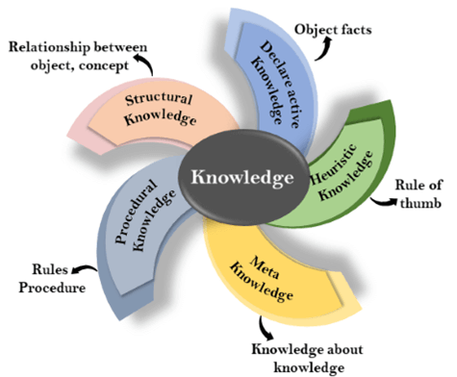
Chapt: 1 Artificial Intelligence and Knowledge Representation
1.7. Knowledge Representation and Mapping schemes
Knowledge: Knowledge is awareness or familiarity gained by experiences of facts, data, and situations.
Types of knowledge in artificial intelligence (1.9. Types of knowledge)

Slide 30
Chapt: 1 Artificial Intelligence and Knowledge Representation
1.7. Knowledge Representation and Mapping schemes
Knowledge: Knowledge is awareness or familiarity gained by experiences of facts, data, and situations.
Types of knowledge in artificial intelligence
1. Declarative Knowledge:
Declarative knowledge is to know about something.
It includes concepts, facts, and objects.
It is also called descriptive knowledge and expressed in declarative sentences.
It is simpler than procedural language.
2. Procedural Knowledge
It is also known as imperative knowledge.
Procedural knowledge is a type of knowledge which is responsible for knowing how to do something.
It can be directly applied to any task.
It includes rules, strategies, procedures, agendas, etc.
Procedural knowledge depends on the task on which it can be applied.

Slide 31
Chapt: 1 Artificial Intelligence and Knowledge Representation
1.7. Knowledge Representation and Mapping schemes
Knowledge: Knowledge is awareness or familiarity gained by experiences of facts, data, and situations.
Types of knowledge in artificial intelligence
3. Meta-knowledge:
Knowledge about the other types of knowledge is called Meta-knowledge.
4. Heuristic knowledge:
Heuristic knowledge is representing knowledge of some experts in a filed or subject. E.g. Salesman Travelling Problem.
Heuristic knowledge is rules of thumb based on previous experiences, awareness of approaches, and which are good to work but not guaranteed.
5. Structural knowledge:
Structural knowledge is basic knowledge to problem-solving.
It describes relationships between various concepts such as kind of, part of, and grouping of something.
It describes the relationship that exists between concepts or objects.

Slide 32
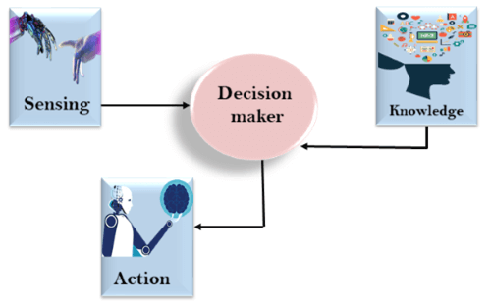
Chapt: 1 Artificial Intelligence and Knowledge Representation
1.7. Knowledge Representation and Mapping schemes
The relation between knowledge and intelligence:

Slide 33
Chapt: 1 Artificial Intelligence and Knowledge Representation
1.7. Knowledge Mapping schemes/Approaches
Four approaches to knowledge representation
Simple relational knowledge
Inheritable knowledge
Inferential knowledge
Procedural knowledge

Slide 34
Chapt: 1 Artificial Intelligence and Knowledge Representation
1.7. Knowledge Mapping schemes/Approaches
Four approaches to knowledge representation
1. Simple relational knowledge:
It is the simplest way of storing facts which uses the relational method, and each fact about a set of the object is set out systematically in columns.
This approach of knowledge representation is famous in database systems where the relationship between different entities is represented.
This approach has little opportunity for inference.
Example: The following is the simple relational knowledge representation.
Player | Weight | Age
Player1 | 65 | 23
Player2 | 58 | 18
Player3 | 75 | 24

Slide 35
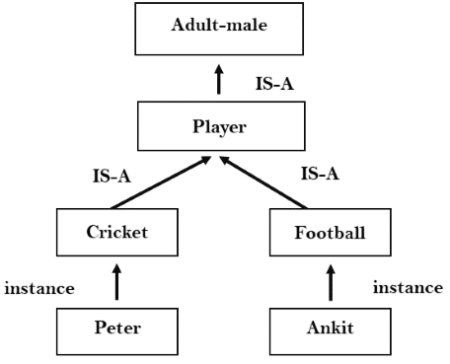
Chapt: 1 Artificial Intelligence and Knowledge Representation
1.7. Knowledge Mapping schemes/Approaches
Four approaches to knowledge representation
2. Inheritable knowledge:
In this all data must be stored into a hierarchy of classes.
All classes should be arranged in a generalized form or a hierarchal manner.
Elements inherit values from other members of a class.
This approach contains inheritable knowledge which shows a relation between instance and class, and it is called instance relation.
Every individual frame can represent the collection of attributes and its value.
In this approach, objects and values are represented in Boxed nodes.

Slide 36
Chapt: 1 Artificial Intelligence and Knowledge Representation
1.7. Knowledge Mapping schemes/Approaches
Four approaches to knowledge representation
3. Inferential knowledge:
Inferential knowledge approach represents knowledge in the form of formal logics.
This approach can be used to derive more facts.
It guaranteed correctness.
Example: Let's suppose there are two statements:
1. Marcus is a man
2. All men are mortal Then it can represent as; 1. man(Marcus) 2. ∀x = man (x) ----------> mortal (x)s
*∀ =for all
→= Implies

Slide 37
Chapt: 1 Artificial Intelligence and Knowledge Representation
1.7. Knowledge Mapping schemes/Approaches
Four approaches to knowledge representation
4. Procedural knowledge:
It uses small programs and codes which describes how to do specific things, and how to proceed.
The rule used If-Then rule.
In this knowledge, we can use various coding languages such as LISP language and Prolog language.
We can easily represent heuristic or domain-specific knowledge using this approach.
e.g. 1
If : Headache and high fever
Then : Viral Fever
e.g. 2
If : Light is Red
Then : Stop

Slide 38
Chapt: 1 Artificial Intelligence and Knowledge Representation
1.8. Properties of good knowledge-based system
A good knowledge representation system must possess the following properties.
Representational Accuracy: KR system should have the ability to represent all kind of required knowledge.
2. Inferential Adequacy:
KR system should have ability to manipulate the representational structures to produce new knowledge corresponding to existing structure.
3. Inferential Efficiency:
The ability to direct the inferential knowledge mechanism into the most productive directions.
4. Acquisitional efficiency-
The ability to acquire the new knowledge easily using automatic methods.

Slide 39
Chapt: 1 Artificial Intelligence and Knowledge Representation
1.10. Knowledge Representation issues
There are some common issues of knowledge representation in AI. They are:
Important Attributes
Relationship among Attributes
Choosing Granularity
Set of Objects
Finding Right Structure

Slide 40
Chapt: 1 Artificial Intelligence and Knowledge Representation
1.10. Knowledge Representation issues
There are some common issues of knowledge representation in AI. They are:
Important Attributes
Any Attribute of objects that may occur in every problem domain
2. Relationship among Attributes
a) Consistency
b) IS A Hierarchy- Generalization, Specialization
c) Reasoning for a Value. E.g. Age-Students’s Can not be Grater than his
parent’s Age
d) Single Valued Attribute- Unique Value. E.g. RollNo.
3. Choosing Granularity
Up to what level knowledge can be represented and what are primitives
4. Set of Objects
How the set of Objects are represented (Universal Quantifier- which is interpreted as "given any" or "for all". It expresses that a predicate can be satisfied by every member of a domain )
5. Finding Right Structure

Slide 41
Chapt: 1 Artificial Intelligence and Knowledge Representation
1.11. AND-OR Graph
Useful for solution of Problem by decomposing in to set of smaller problem until all of which get solved.
OR- Node represent choice possible
AND- Node represents given decomposition
Goal: Acquire a TV Set
Goal: Steal a TV
Goal: Earn a Money
Goal: Buy a Money
More Examples

Slide 42
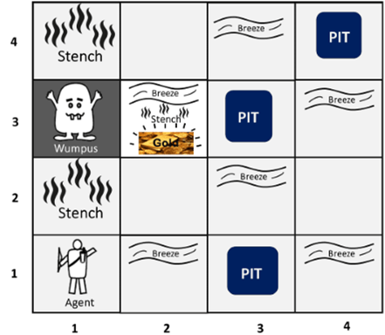
Chapt: 1 Artificial Intelligence and Knowledge Representation
1.12. The Wumpus World
The example to illustrate the worth of a knowledge-based agent and to represent knowledge representation
Wumpus world is a cave which has 4/4 rooms connected with passageways

Slide 43
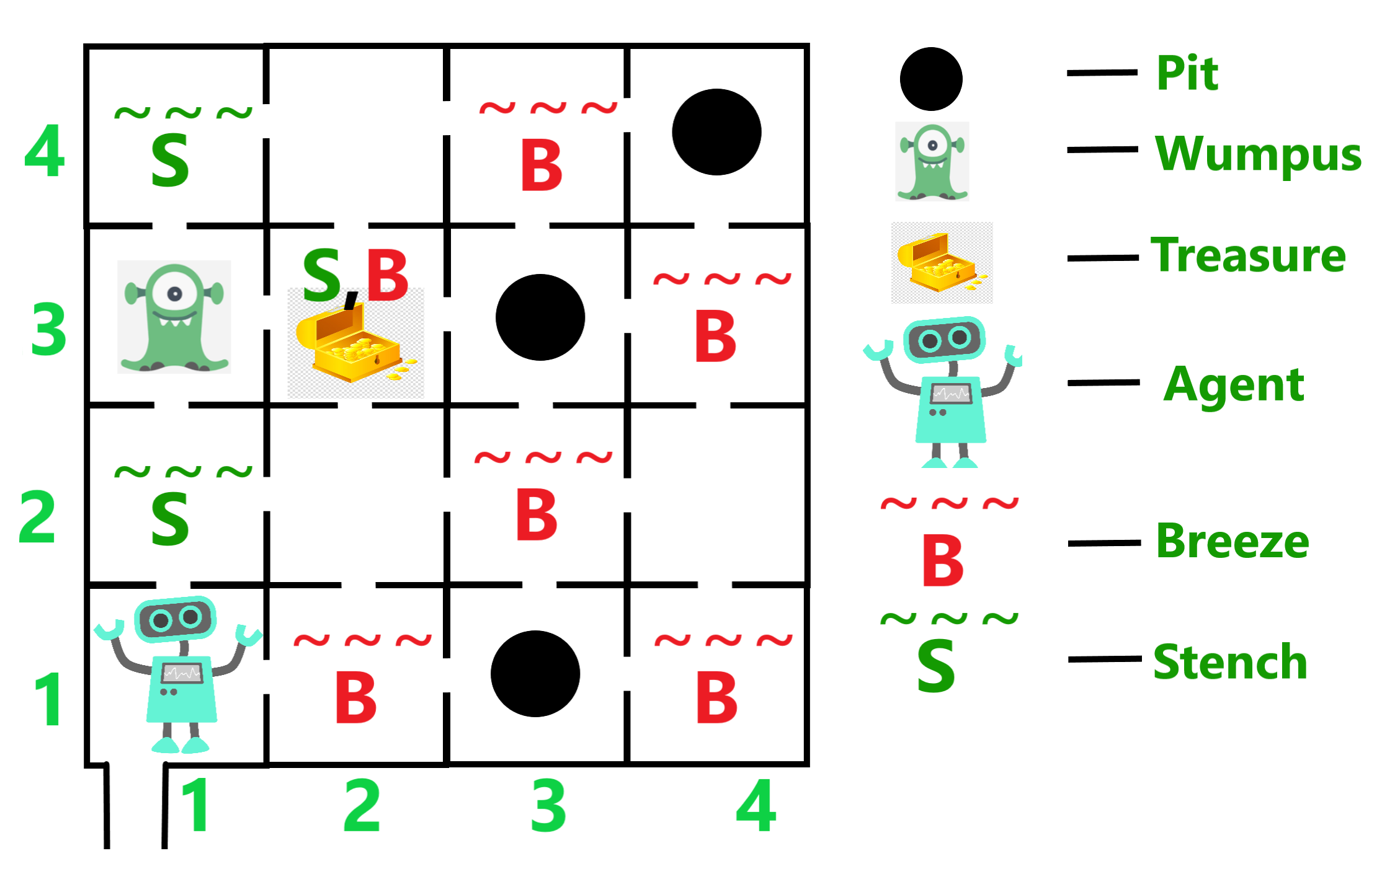
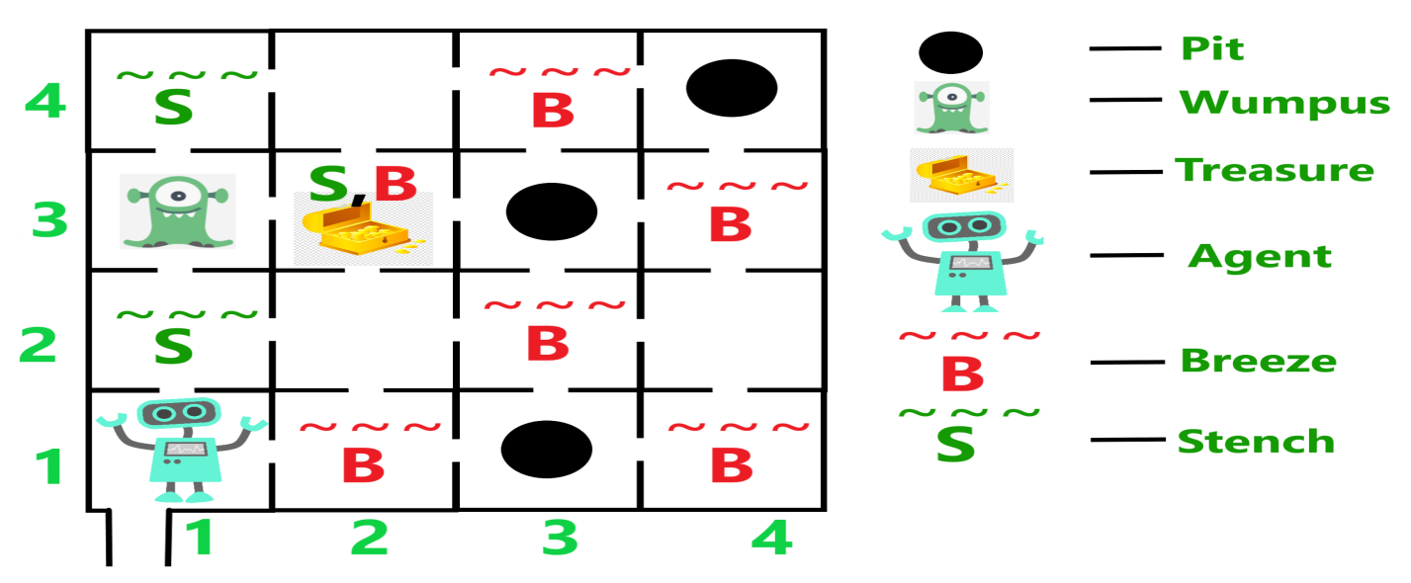
Chapt: 1 Artificial Intelligence and Knowledge Representation
1.12. The Wumpus World

Slide 44
Chapt: 1 Artificial Intelligence and Knowledge Representation
1.12. The Wumpus World
Atomic proposition variable for Wumpus world:
Let P_{i,j} be true if there is a Pit in the room [i, j].
Let B_{i,j} be true if agent perceives breeze in [i, j].
Let W_{i,j} be true if there is wumpus in the square[i, j].
Let S_{i,j} be true if agent perceives stench in the square [i, j].
Let V_{i,j} be true if that square[i, j] is visited.
Let G_{i,j} be true if there is gold (and glitter) in the square [i, j].
Let OK_{i,j} be true if the room is safe.

Slide 45
Chapt: 1 Artificial Intelligence and Knowledge Representation
Propositional logic?
Propositional logic is the foundation of artificial intelligence. It is the idea that statements can be true or false (1 or 0) and that relationships between the statements can be discovered by logical and mathematical rules
It is a technique of knowledge representation in logical and mathematical form.

Slide 46
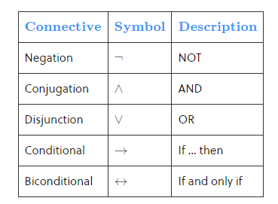
Chapt: 1 Artificial Intelligence and Knowledge Representation
1.12. The Wumpus World
proposition Logic Symbols

Slide 47
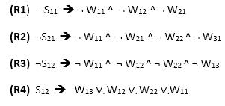
Chapt: 1 Artificial Intelligence and Knowledge Representation
1.12. The Wumpus World-
Some Propositional Rules for the wumpus world:

Slide 48
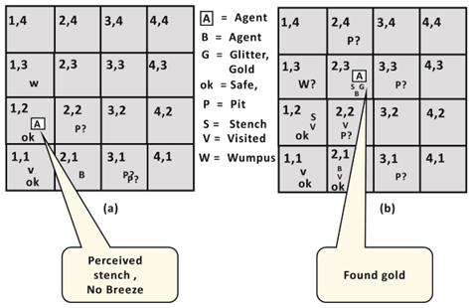
Chapt: 1 Artificial Intelligence and Knowledge Representation
1.12. The Wumpus World- Agent's First step:

Slide 49
Chapt: 1 Artificial Intelligence and Knowledge Representation
References
https://medium.com/myroadtoartificialintelligence/branches-of-artificial-intelligence-812b8e292cdb
https://www.nibusinessinfo.co.uk/content/risks-and-limitations-artificial-intelligence-business
Wikipedia
https://www.youtube.com/watch?v=3MW3ICnkQ9k

